Slide 1
CUSTOMER ACCOUNT BANK MANAGEMENT SYSTEM
SPRINT-2 EVALUATION
ON
PRESENTED BY:
AKULA APARNA
AKULA SAI GANESH
CH SAVITHA
MAHESH CHENNA

Slide 2
CONTENTS
AIM
PROBLEM DESCRIPTION
SOURCE CODE
OUTPUT SNAPSHOTS
CONCLUSION

Slide 3
AIM
To develop a software for solving financial applications of a customer in banking environment in order to nurture the needs of an end banking user by providing various ways to perform banking tasks.
Also to enable the user’s workspace to have additional functionalities which are not provided under a conventional banking software.

Slide 4
Problem Description
The bank management system is an application for maintaining a person’s account in a bank. This project is focused on customer account services in bank, so it is named “Customer Account Bank Management System”.
Here, you can create a new account, update information of an existing account, view and manage transactions, check the details of an existing account, remove existing account and view customers’ list.
Overall, with this project, you can perform banking activities like in a REAL bank.

Slide 5
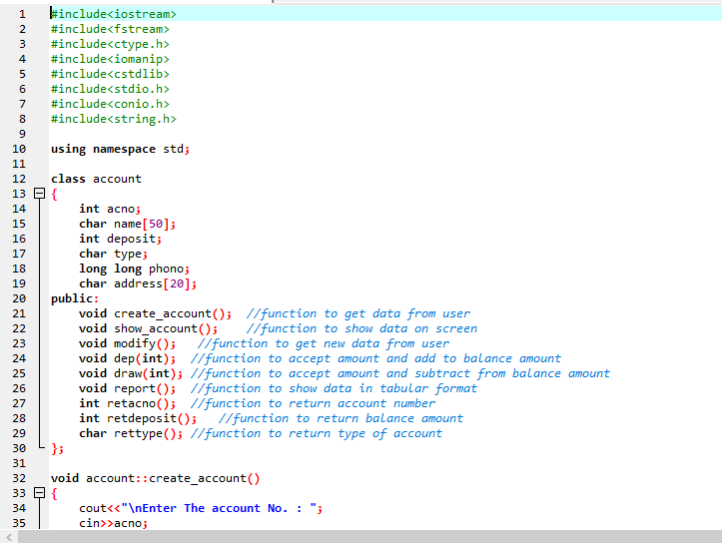
SOURCE CODE

Slide 6
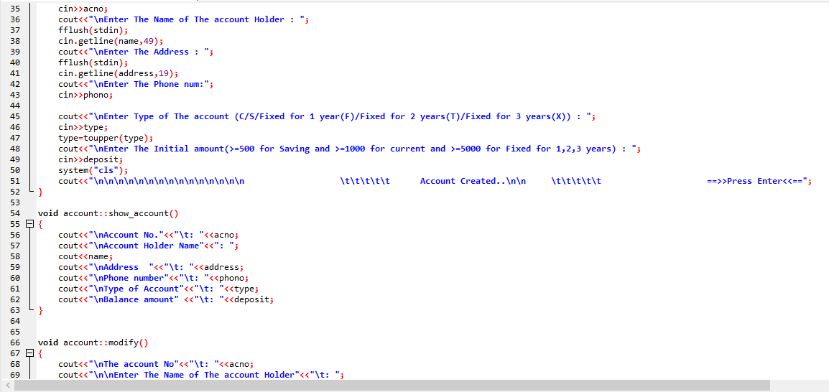

Slide 7
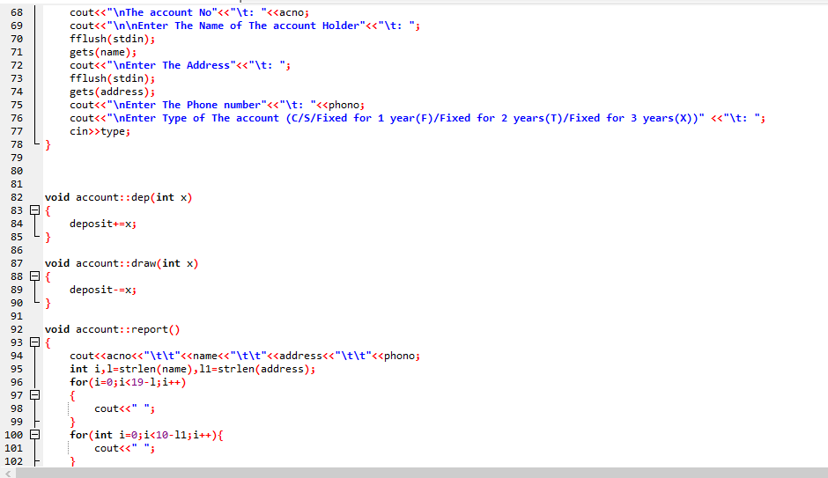

Slide 8
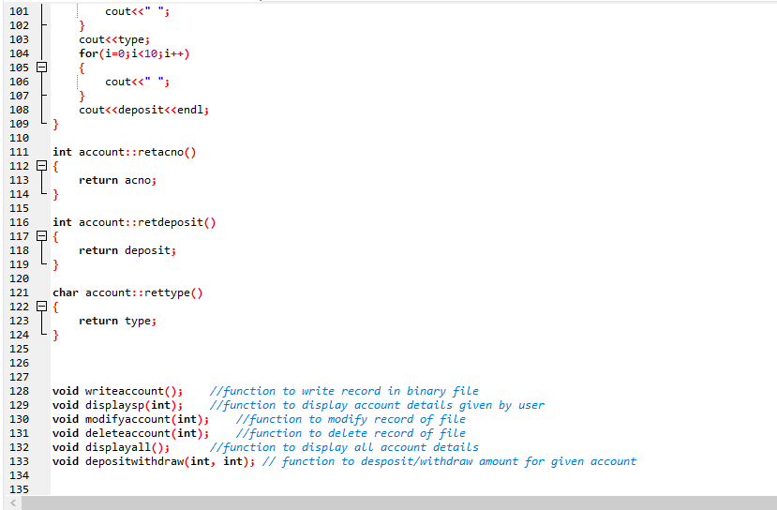

Slide 9
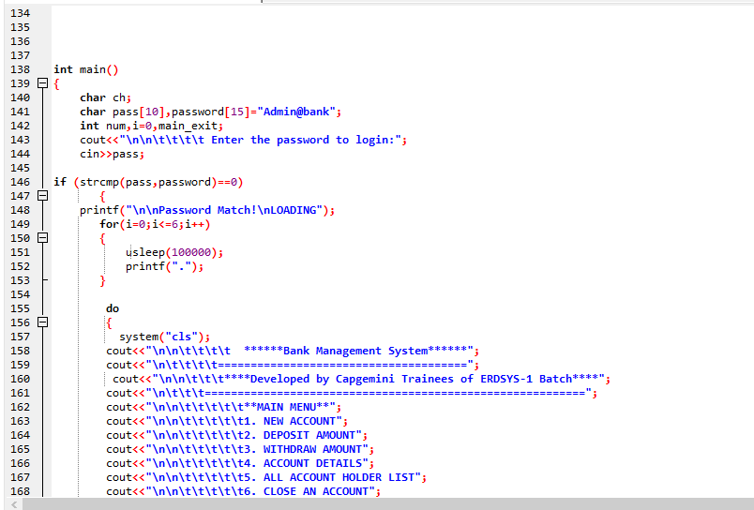
LOGIN MODULE

Slide 10
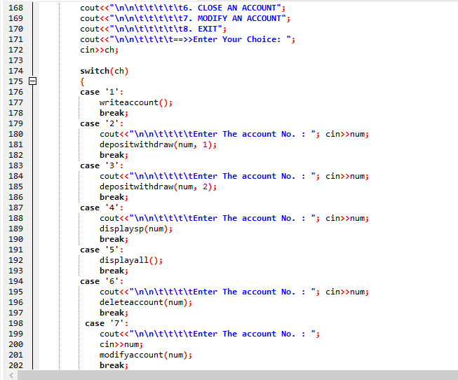

Slide 11
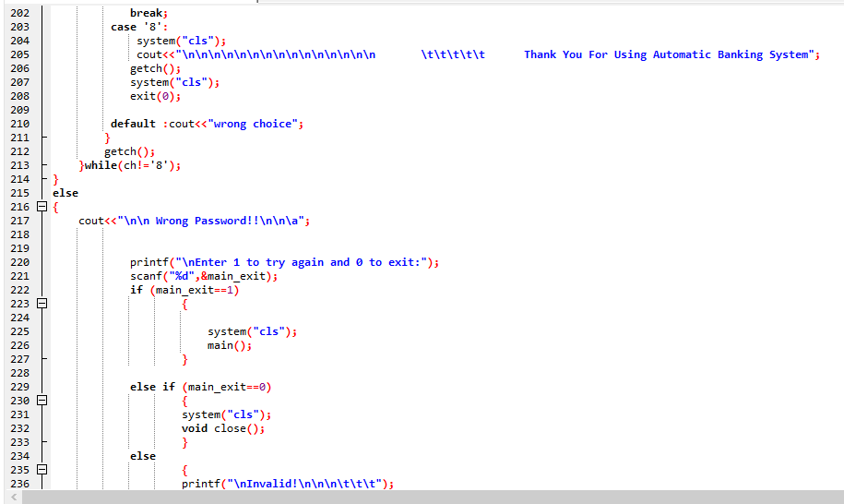
EXIT MODULE

Slide 12
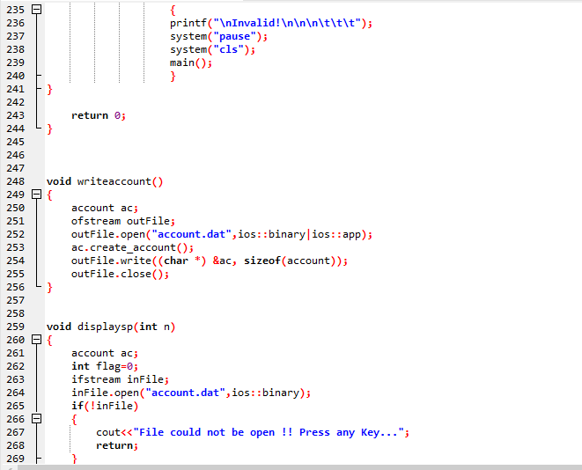
WRITING ACCOUNT TO ACCOUNT.DAT FILE

Slide 13
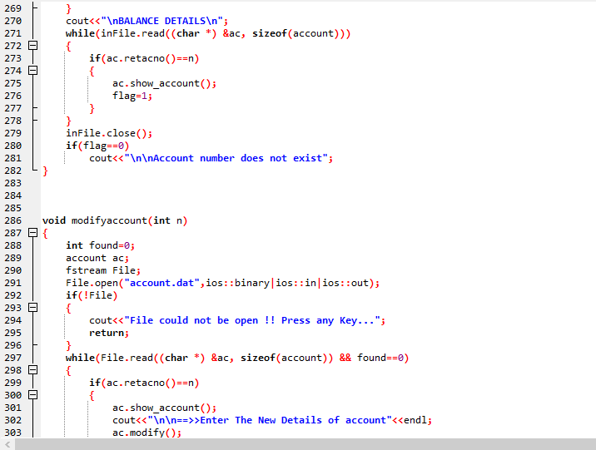
MODIFY MODULE

Slide 14
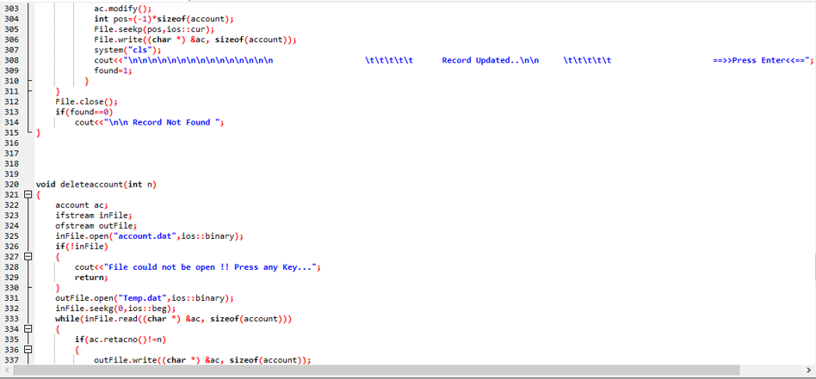
DELETE MODULE

Slide 15
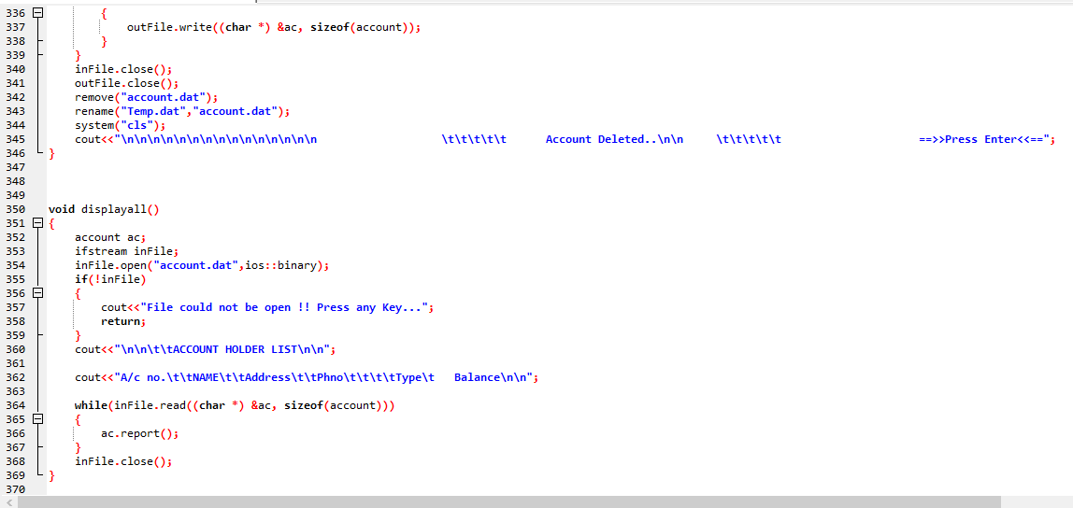
DISPLAY MODULE

Slide 16
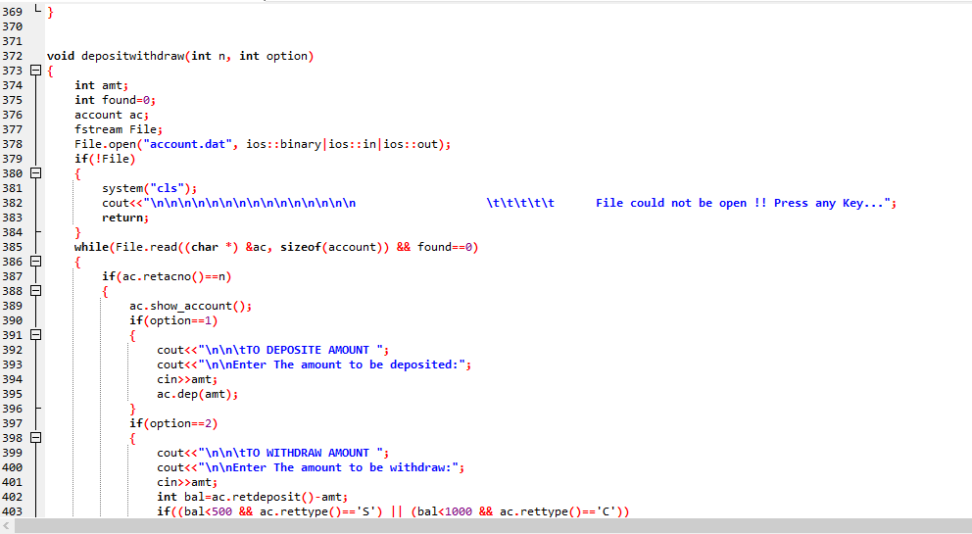
DEPOSIT AND WITHDRAW MODULES

Slide 17
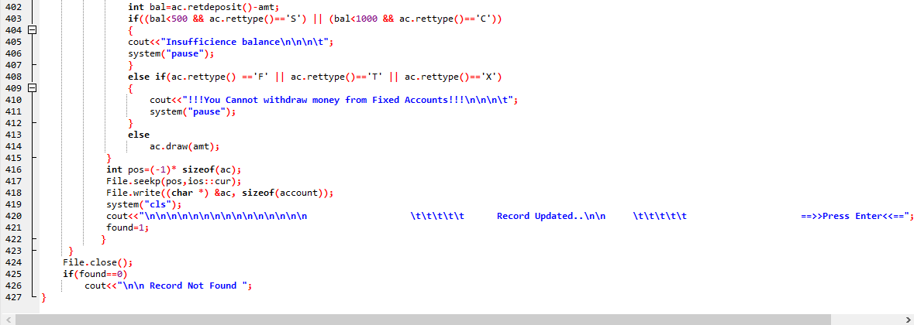

Slide 18
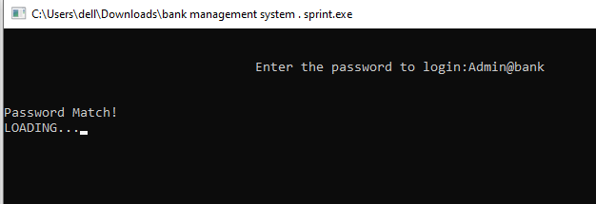
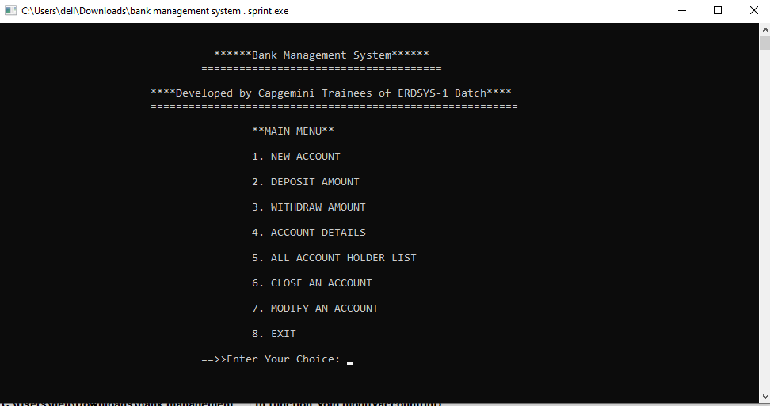
OUTPUT SNAPSHOTS

Slide 19
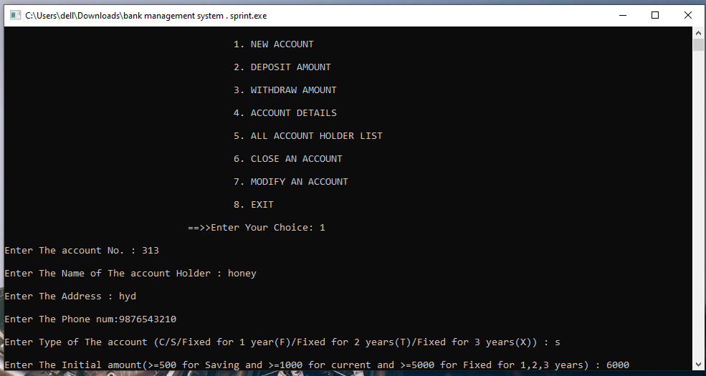
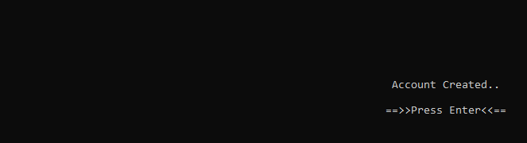
NEW ACCOUNT

Slide 20
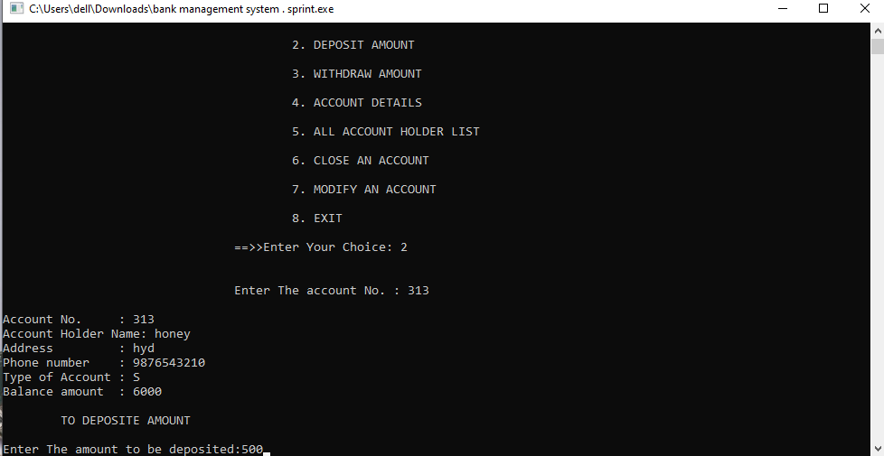
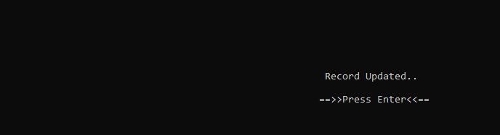
DEPOSIT AMOUNT

Slide 21
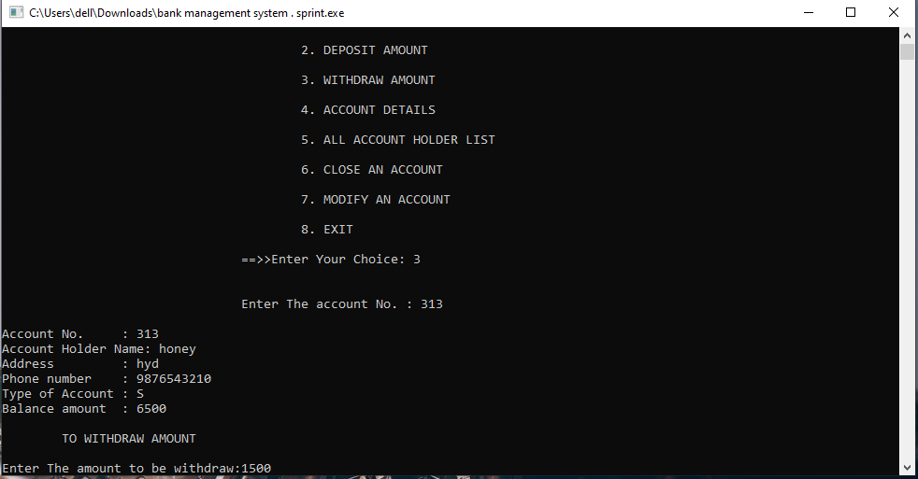
WITHDRAW AMOUNT

Slide 22
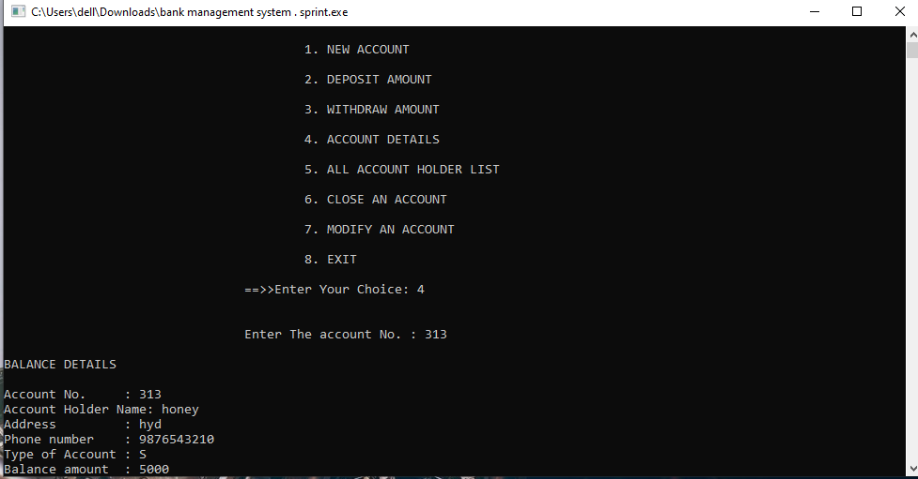
ACCOUNT DETAILS

Slide 23
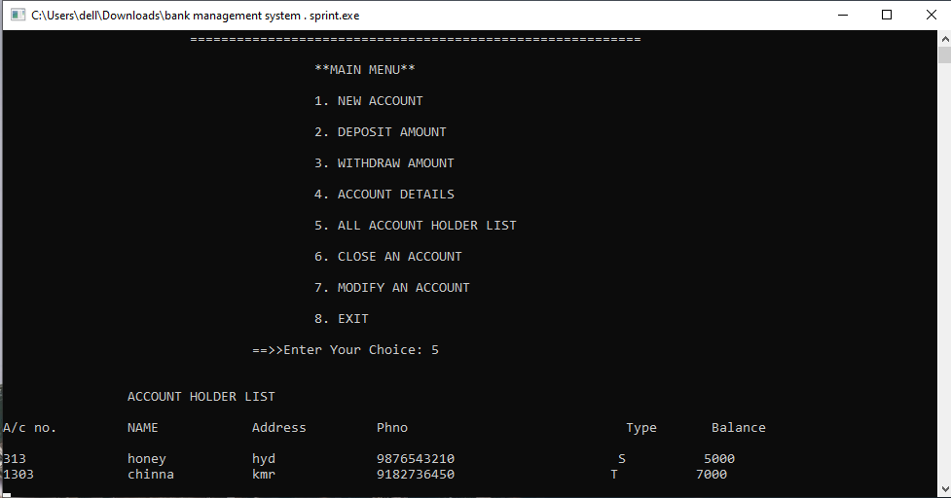
ALL ACCOUNT HOLDER LIST

Slide 24
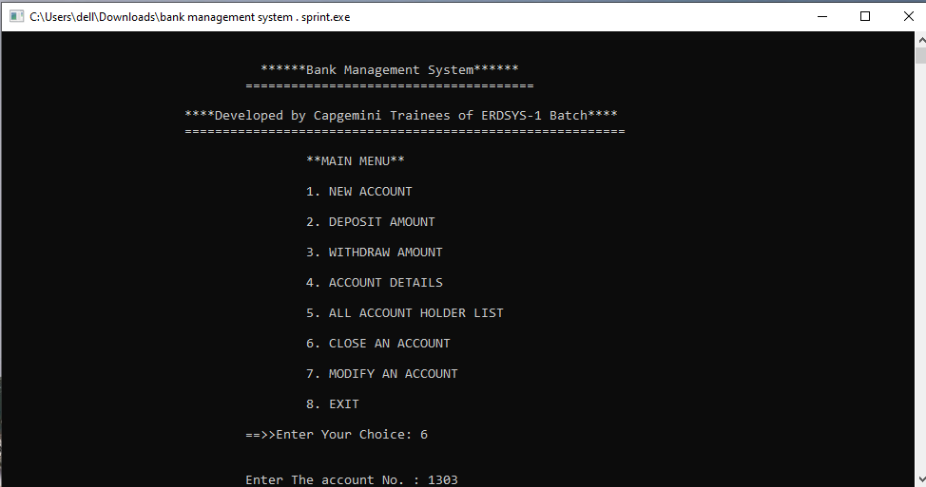
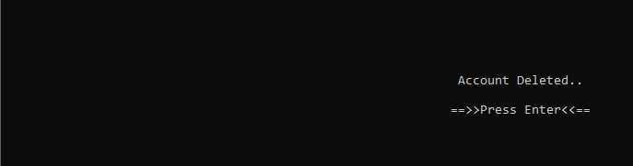
CLOSE AN ACCOUNT

Slide 25
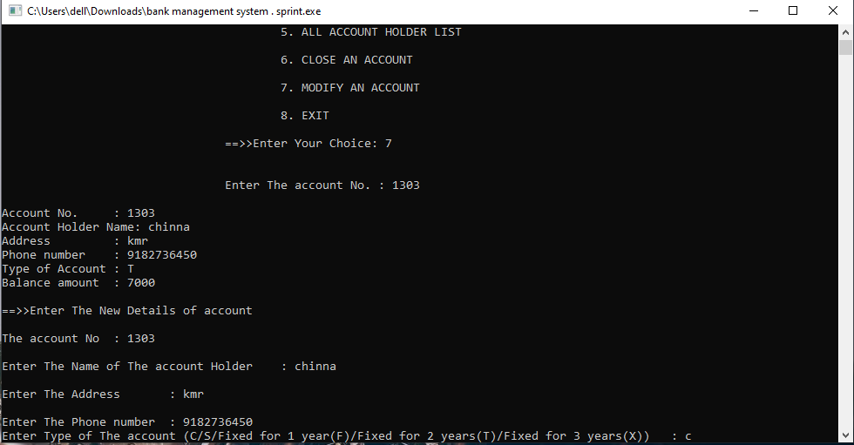
MODIFY AN ACCOUNT

Slide 26
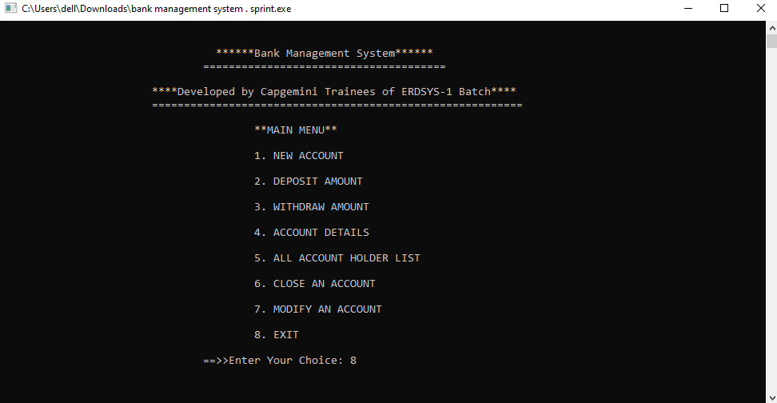

EXIT

Slide 27
CONCLUSION
This project is developed to nurture the needs of a user in a banking sector by embedding all the tasks of transactions taking place in a bank.
Future version of this software will still be much enhanced than the current version.
Thus the Bank Management System it is developed and executed successfully.

Slide 28
THANK YOU

